Slide 1
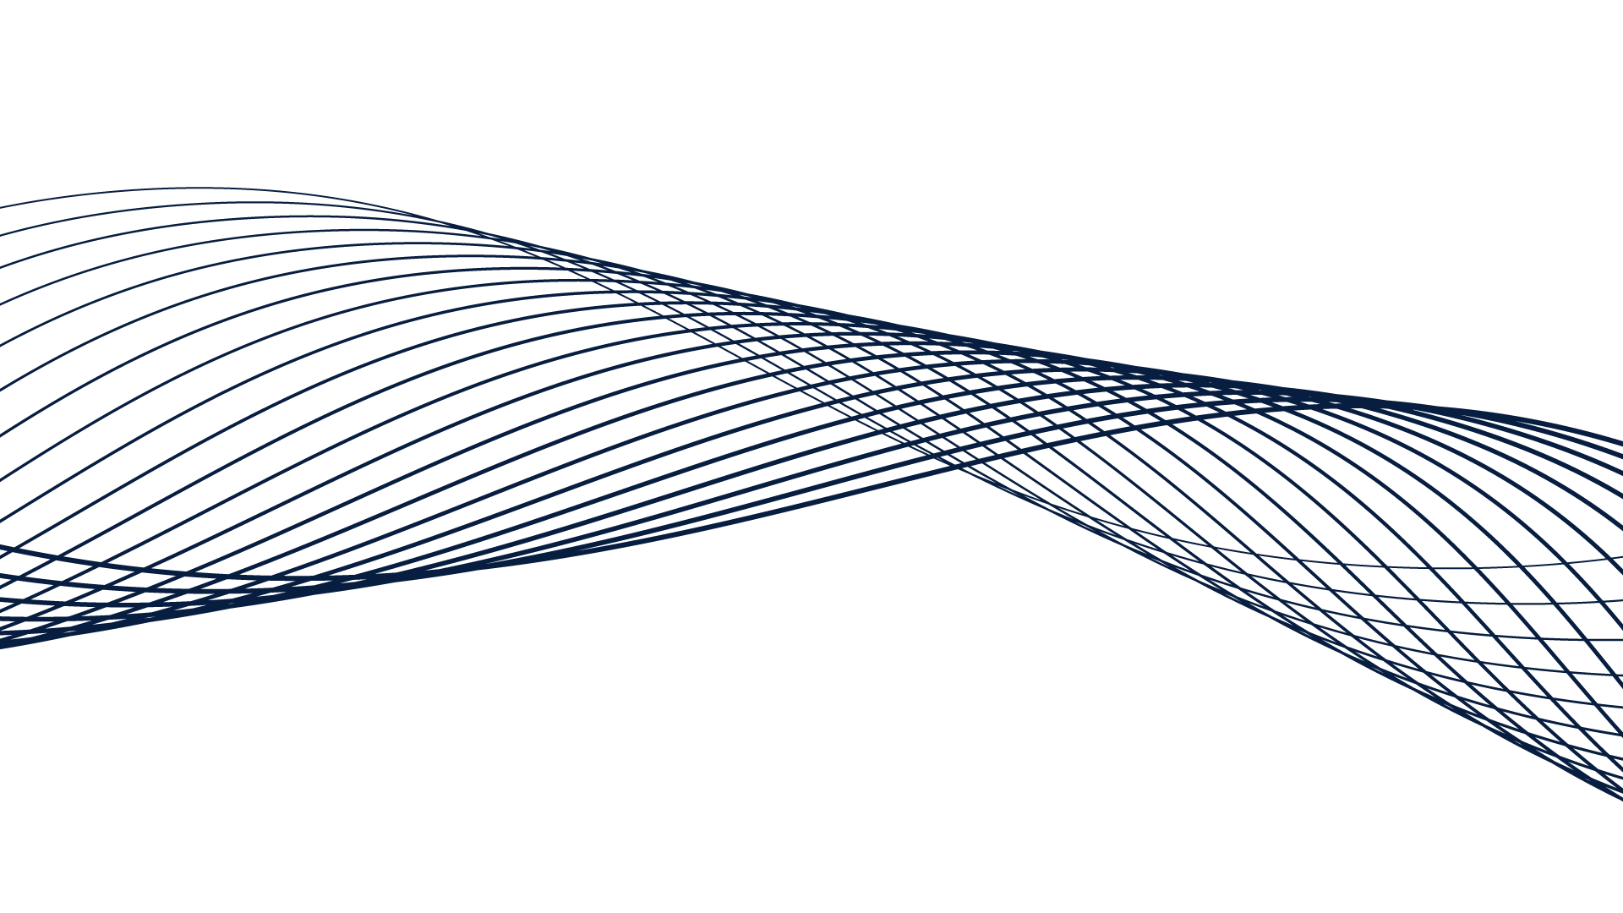


Total Rewards Software
Making a High Impact Case for

Slide 2




Employee Engagement & Retention is Headed for a Change of Scenery…
$
+ Growth
+ Passion
+ Wellness
- Money

Slide 3
7/10 Employees
Aren't Engaged at Work...Why?
“
Humans, by their nature, seek purpose—
a cause greater and more enduring than themselves. But traditional businesses have long considered purpose ornamental...
”
- Dan Pink, Drive

Slide 4

The New
Candidate Landscape
Only 30%
of Today’s Job Seekers are Motivated by Money
70% Focus on
Other Factors
  Career path
  Work-life balance
  Benefits
  Flexibility
  Meaningfulness
  Purpose
  Co-workers/Manager

Slide 5

A Healthy Economy
Affects Total Rewards
A Strong Economy
+ Low Unemployment
= Increased Competition for Employees

Slide 6

Gen-Y Employees
By 2025, Millennials will make up 75% of the global workforce.
http://www.forbes.com/sites/danschawbel/2013/09/04/why-you-cant-ignore-millennials/
91% of Millennials expect to stay in a job for less than three years
http://www.forbes.com/sites/jeannemeister/2012/08/14/job-hopping-is-the-new-normal-for-millennials-three-ways-to-prevent-a-human-resource-nightmare/
Young professionals desire transparency and on-demand accessibility of information regarding their comp structure.

Slide 7

HR Professionals See These Challenges in Living Color and Know a Total Rewards Solution is
Worth The Time & Money

Slide 8


What are HR’s Options for Total Rewards?
?
Do the Same Old Things
DIY Spreadsheet
Outsource the Solution
Centralized Employee
Value Communication

Slide 9


How Can We Communicate Employee Value Better?
As a global leader in total compensation strategy and communication, TotalRewards Software provides solutions designed to meet an organization’s needs:
Paper Statements
Visual appeal
Personalized detail
Purpose-driven rewards
(career path, wellness, work/life balance)
Software (the best of all worlds!)
Online Statements
On-demand access
Centralization
Simple setup
Usage/tracking reports

Slide 10


It’s All in the Name –
TotalRewards Software
Purpose-Built Technology
Affordable Solutions
Comprehensive Programs

Slide 11
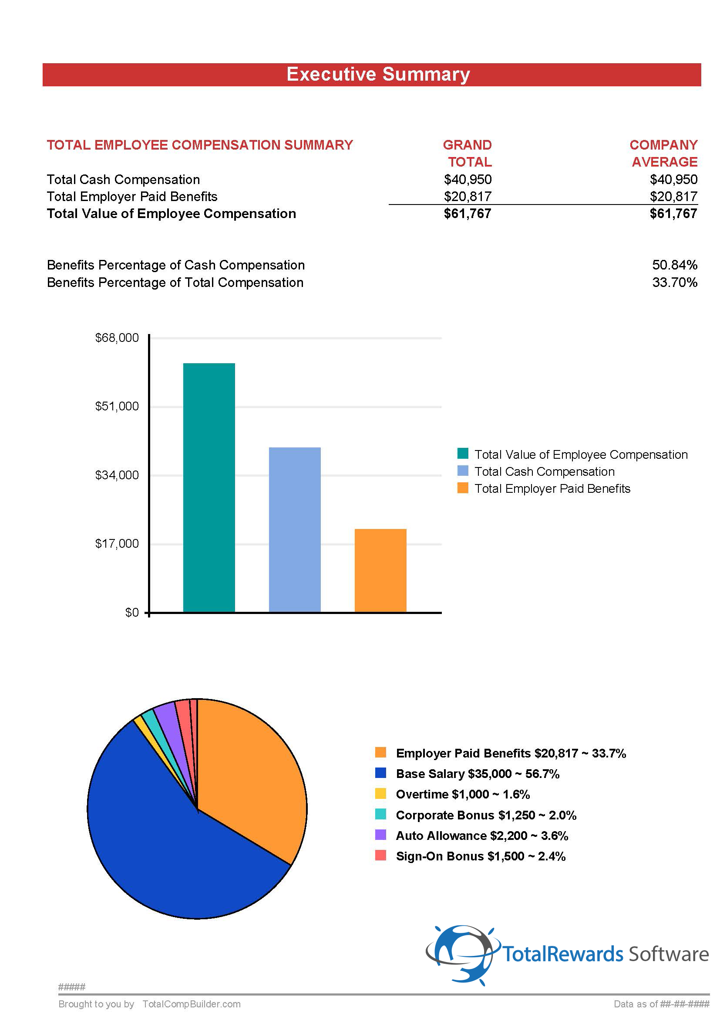
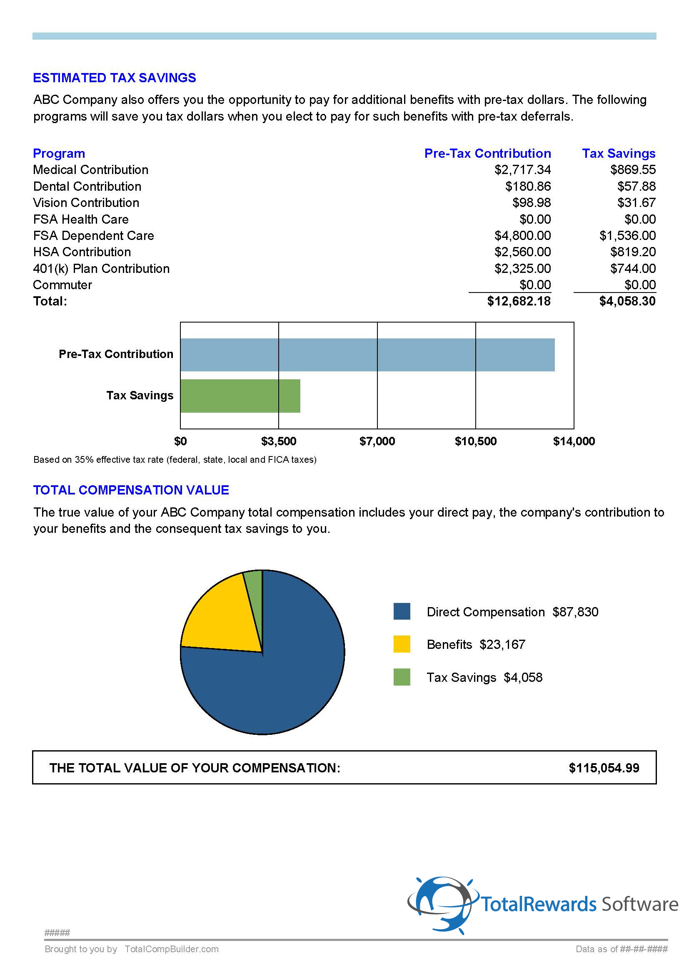
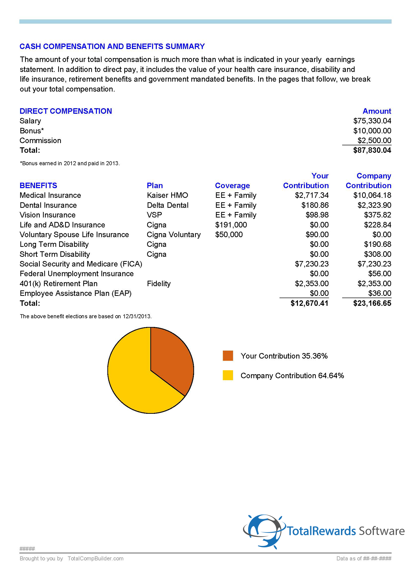
Examples from TotalRewards Software

Slide 12


Set up a free account or request a demo project with
TotalRewards Software today!
Take the Tour
To learn more
Visit
Or Call
TotalRewardsSoftware.com
866-478-6428

